Slide 1

Principal component analysis (PCA) for facial recognition
Mathematics for AI Group Presentation
Team Members: Chong Zhi Zhen, Daniel Simmons,
Jorge Apatiga, Sagar Pratap Singh, Yang Qingwei

Slide 2

AGENDA
INTRODUCTION
Principal Component ANAlysis
How PCA Learns from Face Space
Algorithm Explanation
DEMO

Slide 3




Introduction
What is Facial Recognition?
Applications
A biometric technology that identifies or verifies a person based on unique facial features
Uses mathematical patterns extracted from images
Often performs feature extraction followed by matching against a database
Security & Authentication
Commercial Applications
Surveillance
Personalization

Slide 4

Principal component analysis (PCA)

Slide 5
What is Principal Component Analysis (PCA)?
A dimensionality-reduction technique that transforms high-dimensional data into a smaller set of important features
Identifies the directions (principal components) where the data varies the most
Projects data onto these components to capture the most essential structure with fewer dimensions
Removes redundant or corelated information while preserving major patterns
Useful for simplifying data, speeding up computation, and reducing noise

Slide 6
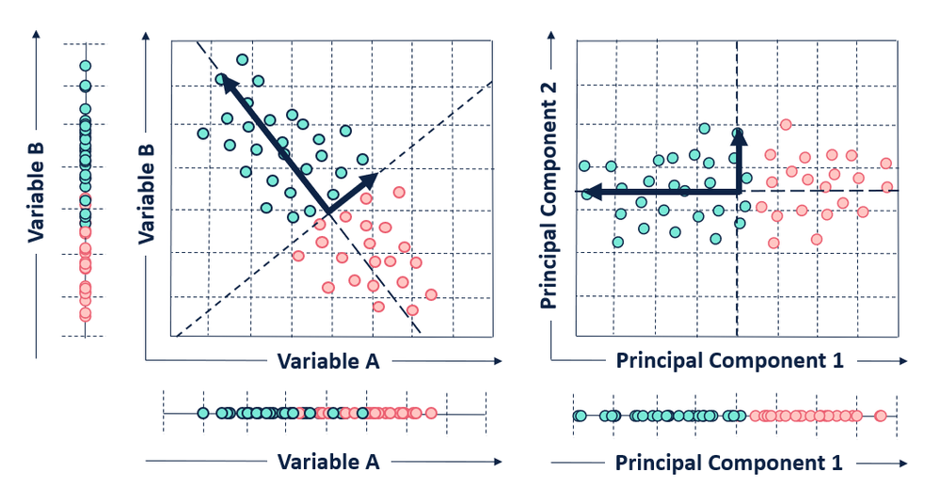
What is Principal Component Analysis (PCA)?
Reduces high-dimensional data into key components
Finds directions of maximum variance (principal component)
Removes redundancy and noise
Keeps the most important features

Slide 7
PCA
What does it do?
Can show the example from the data that Chen sent
Effective body language enhances your message, making it more impactful and memorable:
Meaningful eye contact
Purposeful gestures
Maintain good posture
Control your expressions

Slide 8
How PCA Learns from Face space?
1. Convert each face image into a vector
Flatten a 2D image (e.g., 100×100 pixels → 10,000-dimensional vector)
Each face becomes a point in a very high-dimensional space
2. Build the data matrix
Stack all face vectors column-wise or row-wise
Each column = one face sample
3. Compute the mean face
Average all face vectors
Subtract this mean from every face vector → center the data
4. Compute the covariance matrix
Measures how pixel intensities vary together across all training faces
Very large (10,000 × 10,000) matrix, so PCA uses a trick:
Compute a reduced covariance matrix from XTXX^T XXTX instead
5. Obtain eigenvalues and eigenvectors
Solve for eigenvectors of the covariance matrix
Each eigenvector = a direction of maximum variance in the dataset
6. Select the top kkk eigenvectors
Sort eigenvectors by descending eigenvalues
The top kkk capture the most important variations among faces
These are called Eigenfaces
7. Construct the “face space”
The selected eigenvectors form a new coordinate system
Any new face can be projected into this reduced subspace
8. Project faces onto this subspace
Multiply the centered face vector by the eigenface matrix
Result = a compact representation (feature vector)
9. Compare projected vectors for recognition
Distance between feature vectors indicates similarity
Closer projection → more likely to be the same identity

Slide 9
Algorithm

Slide 10
Algorithm
Explain step by step what our code does
(can do a flow chart for easier explanation)
Effective body language enhances your message, making it more impactful and memorable:
Meaningful eye contact
Purposeful gestures
Maintain good posture
Control your expressions

Slide 11
Algorithm
This can show some results
(can exclude if we confident in the demo)
Effective body language enhances your message, making it more impactful and memorable:
Meaningful eye contact
Purposeful gestures
Maintain good posture
Control your expressions

Slide 12
Demo

Slide 13

THANK YOU

Slide 14
Quick recap: what is pca
ENHANCING YOUR PRESENTATION

Slide 15
This is a powerful tool in public speaking. It involves varying pitch, tone, and volume to convey emotion, emphasize points, and maintain interest:
Pitch variation
Tone inflection
Volume control
Effective body language enhances your message, making it more impactful and memorable:
Meaningful eye contact
Purposeful gestures
Maintain good posture
Control your expressions

Slide 16
NAVIGATING Q&A SESSIONS
Know your material in advance
Anticipate common questions
Rehearse your responses
Maintaining composure during the Q&A session is essential for projecting confidence and authority. Consider the following tips for staying composed:
Stay calm
Actively listen
Pause and reflect
Maintain eye contact

Slide 17
Dynamic delivery
Learn to infuse energy into your delivery to leave a lasting impression
One of the goals of effective communication is to motivate your audience
METRIC | MEASUREMENT | TARGET | ACTUAL
Audience attendance | # of attendees | 150 | 120
Engagement duration | Minutes | 60 | 75
Q&A interaction | # of questions | 10 | 15
Positive feedback | Percentage (%) | 90 | 95
Rate of information retention | Percentage (%) | 80 | 85

Slide 18
Face recognition demo: Pca in action

Slide 19
FINAL TIPS & TAKEAWAYS
Consistent rehearsal
Strengthen your familiarity
Refine delivery style
Pacing, tone, and emphasis
Timing and transitions
Aim for seamless, professional delivery
Practice audience
Enlist colleagues to listen & provide feedback
Seek feedback
Reflect on performance
Explore new techniques
Set personal goals
Iterate and adapt

Slide 20
SPEAKING ENGAGEMENT METRICS
IMPACT FACTOR | MEASUREMENT | TARGET | ACHIEVED
Audience interaction | Percentage (%) | 85 | 88
Knowledge retention | Percentage (%) | 75 | 80
Post-presentation surveys | Average rating | 4.2 | 4.5
Referral rate | Percentage (%) | 10 | 12
Collaboration opportunities | # of opportunities | 8 | 10

